Slide 1

Video #2
HARDWARE - 1
BEGINNER TO EXPERT GUARANTEED
ULTIMATE IT COURSE
ACCESS NETWORKING COURSE PLAYLIST LINK IN DESCRIPTION
SUBSCRIBE!!!

Slide 2
Hardware?
When Internal and External Components & Peripherals gets combined together then they assemble a computer. And these components and peripherals are known as computer Hardware.

Slide 3
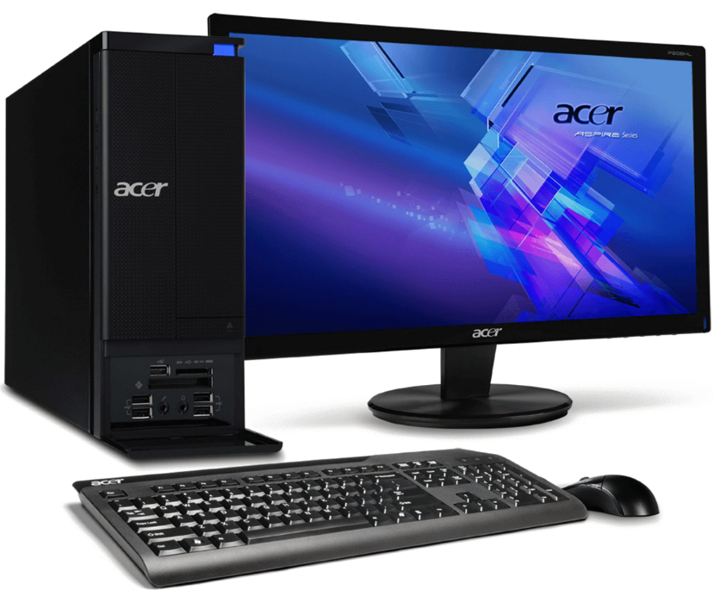
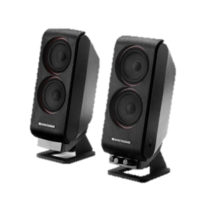

Slide 4
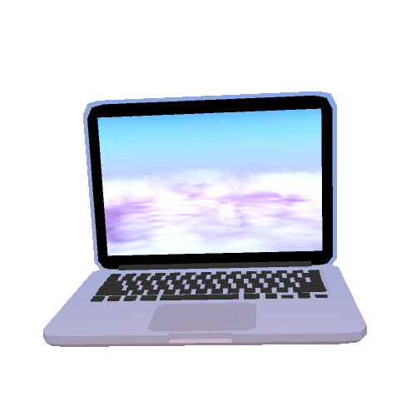
What is Computer???
THE COMPUTER DEFINED
Computer is a dumb machine which works only when it get instructions. The algorithm of working is based on binaries calculations which is 0 & 1. computer is used for doing work faster, easier, highly capacitive & accurately.

Slide 5
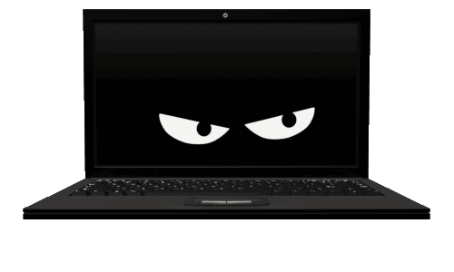
TYPES OF COMPUTER
1. MINICOMPUTER
2. PC/TABLET/SMARTPHONE/LAPTOP (Micro)
3. WORKSTATION
4. MAINFRAME
5. SUPERCOMPUTER

Slide 6
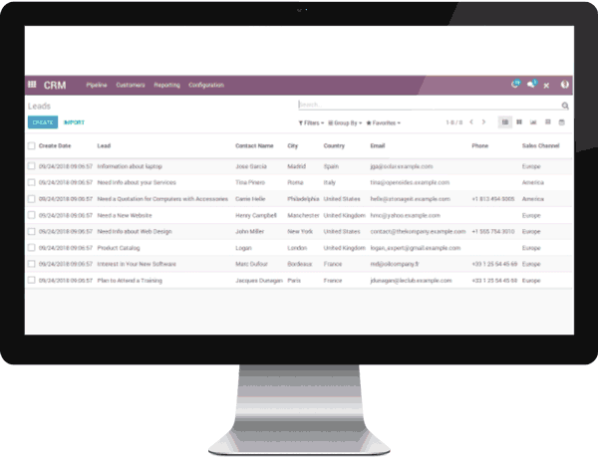
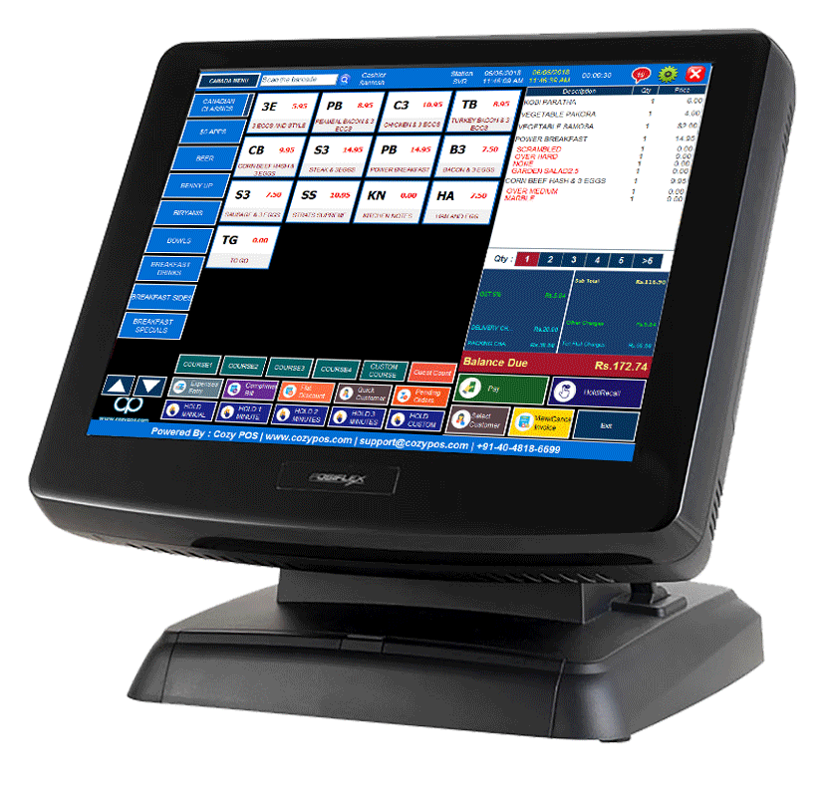
Mini Computer
1.
Minicomputers are used by small businesses & firms. Minicomputers are also called as “Midrange Computers”. They are designed for special purposes like cash billing, Ticket booking & smart systems.

Slide 7
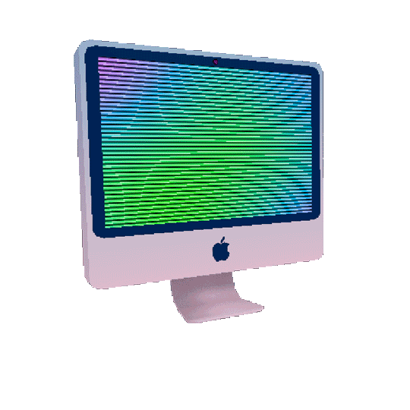
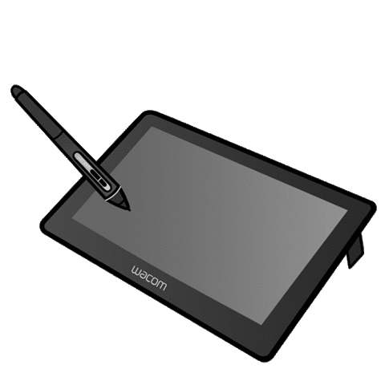
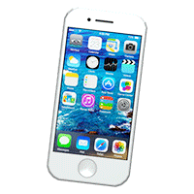
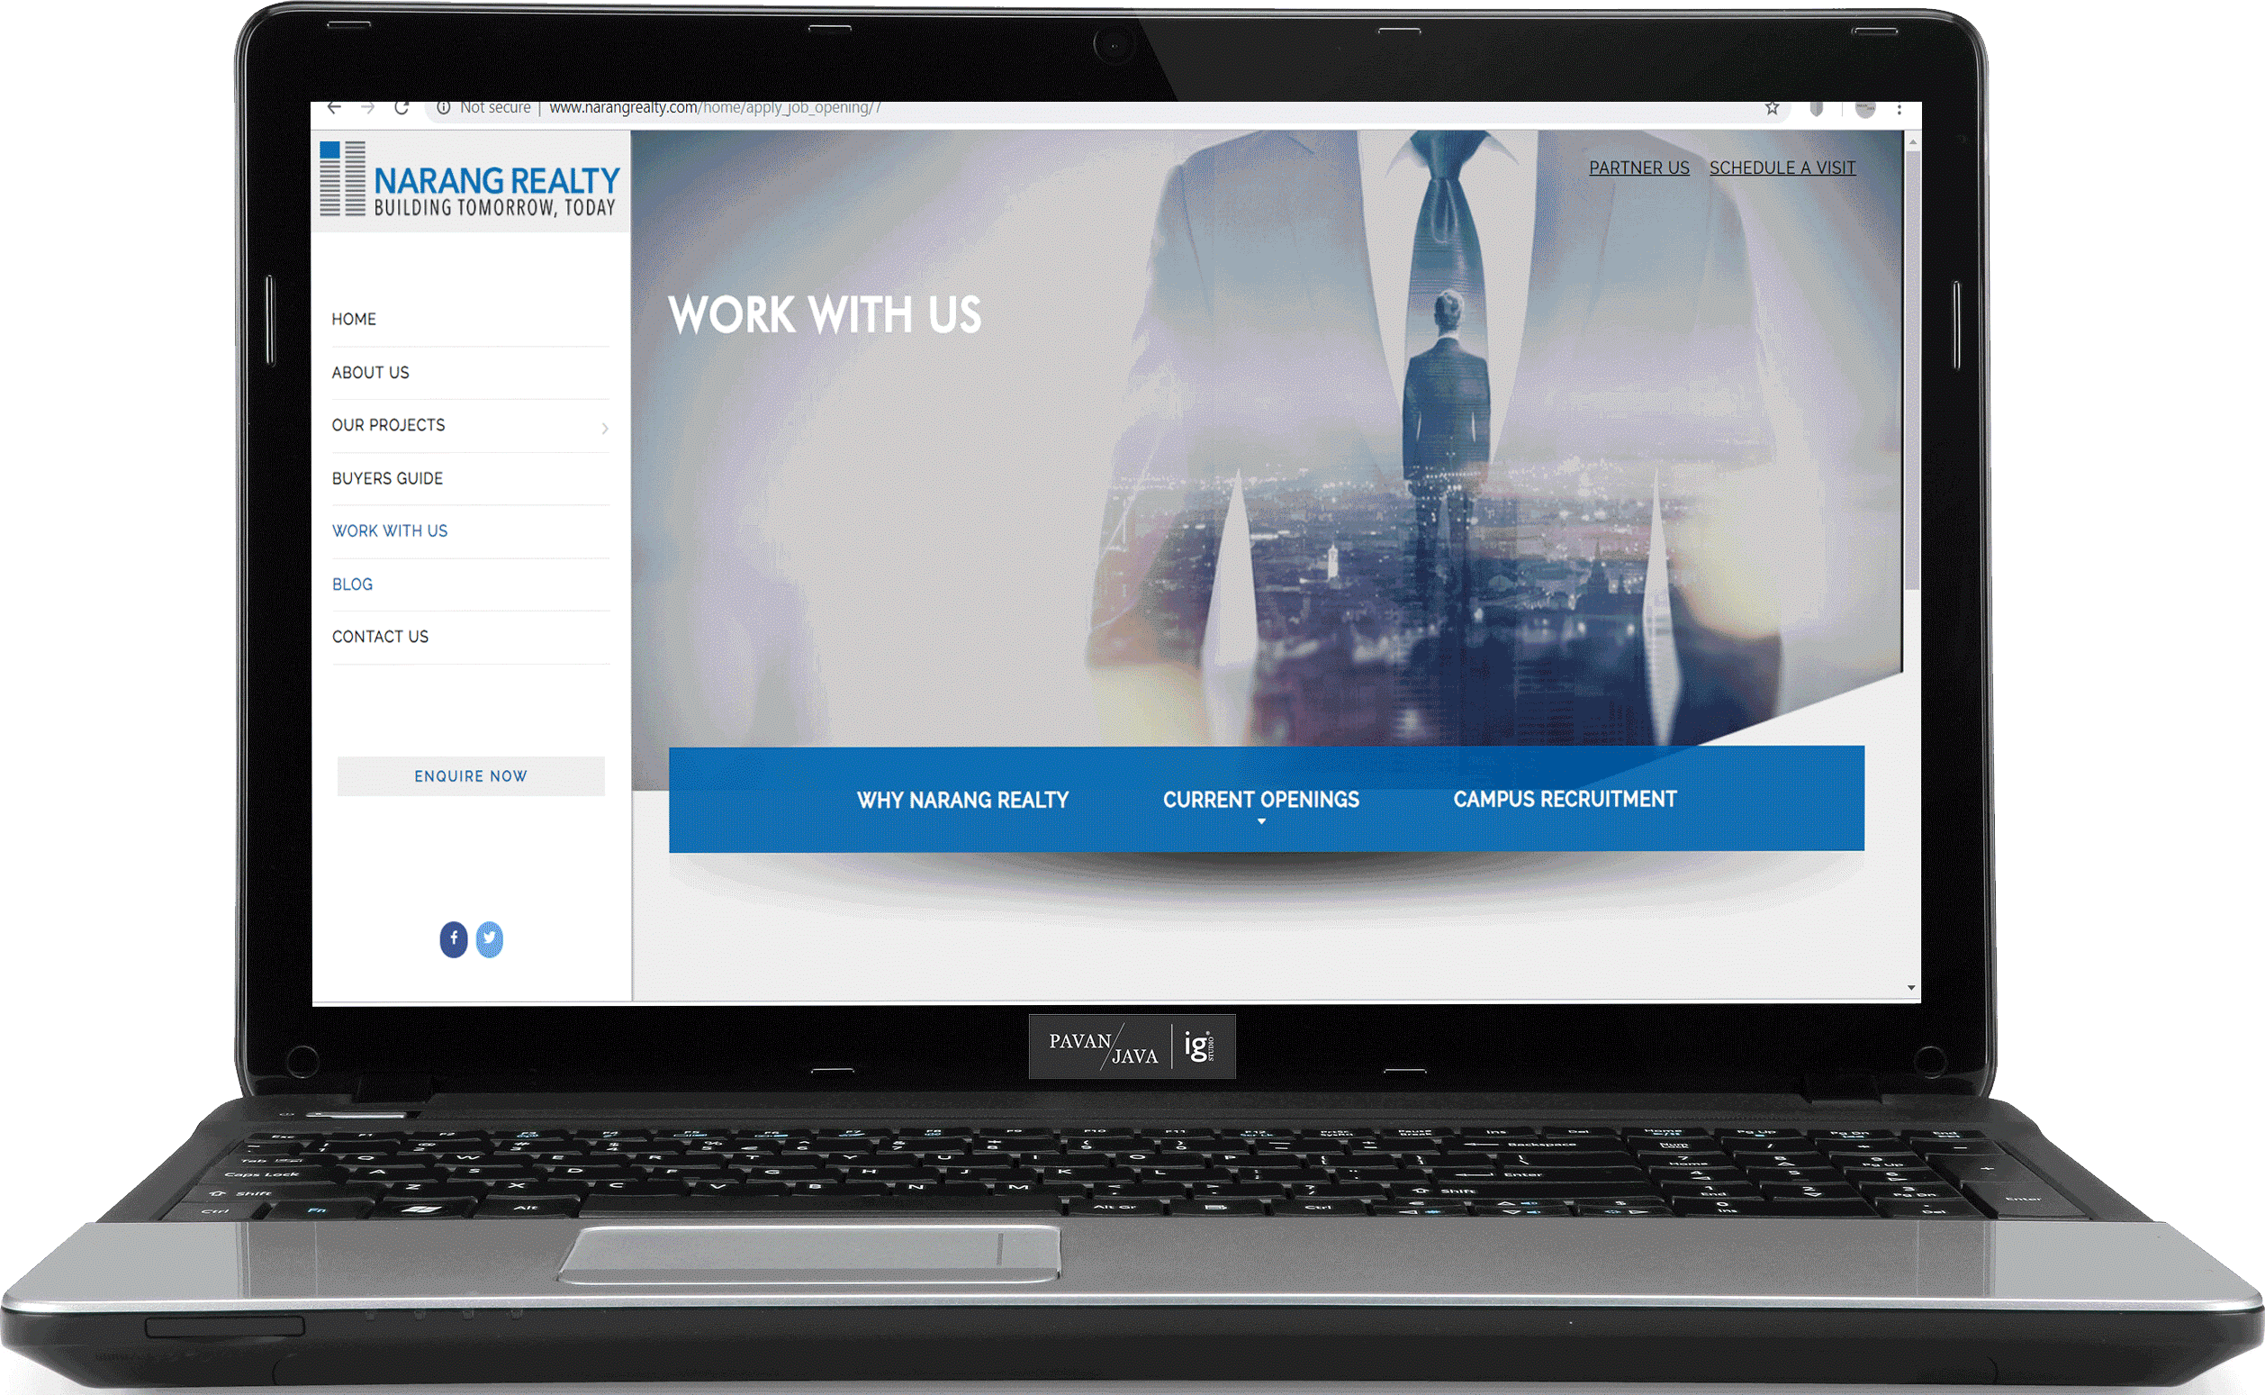
2.
Micro Computer
Desktop computers, Tablet PC’s, Smartphones, Calculators are all type of Microcomputers. They are handy and portable in some cases. Low capacitive and meant for normal uses.

Slide 8
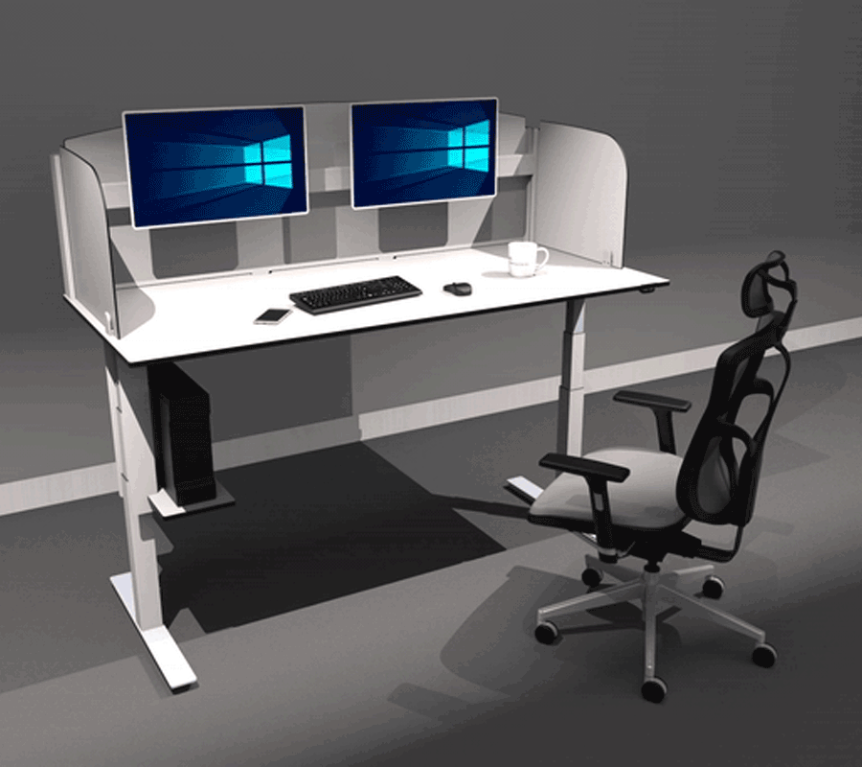
Workstation
3.
These are specially designed systems meant for special purposes like gaming, stock stalking & whether forcasting. Basically a well profiled and maintained setup.

Slide 9
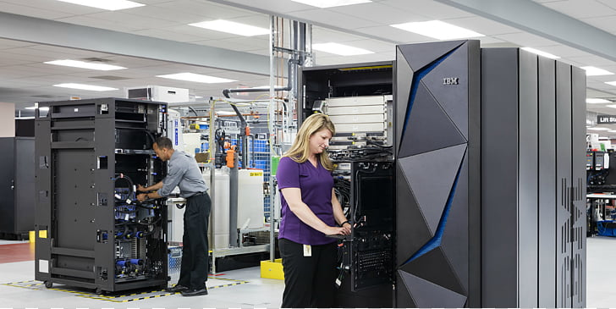
Mainframe
4.
A large, powerful computer that can handle many tasks concurrently and is usually used commercially. Mainframes are not as powerful as supercomputers. Mainframes can also process & store large amount of data.

Slide 10
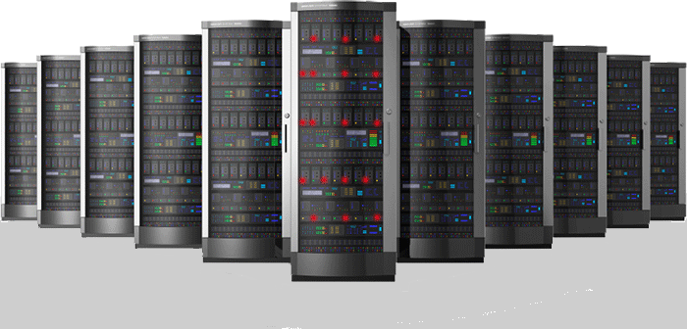
5.
Super Computer
Supercomputers are the most powerful computers made, and physically they are some of the largest. These systems can process huge amounts of data, and the fastest supercomputers can perform more than one trillion calculations per second.

Slide 11
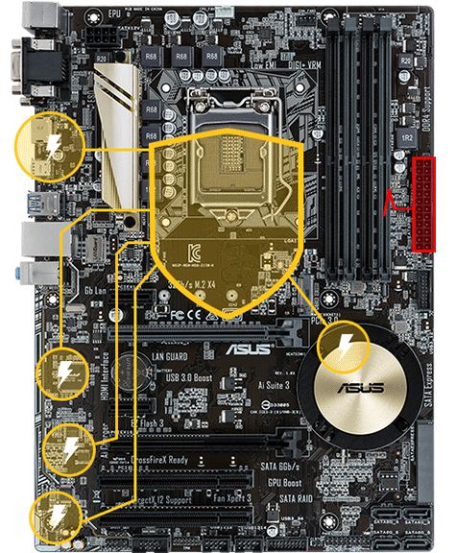
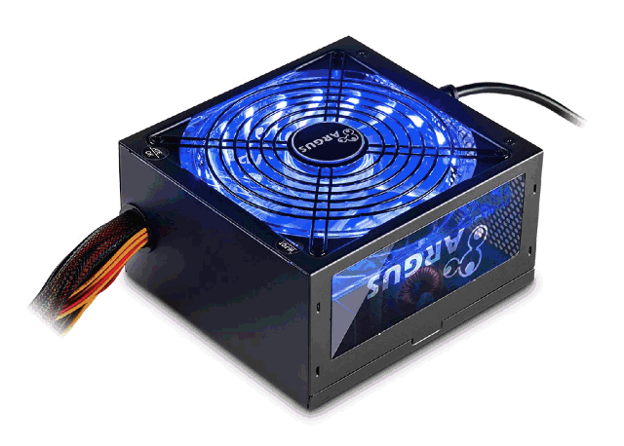
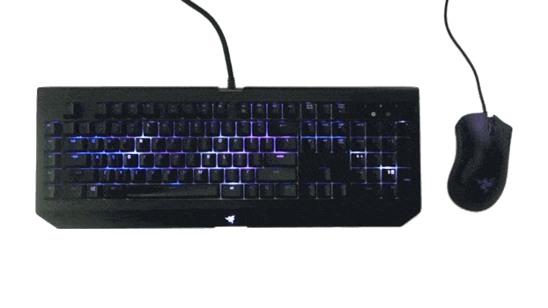
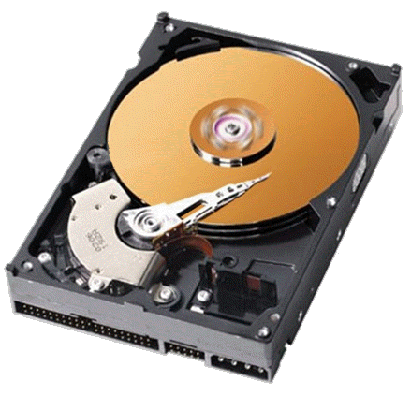
Assembling a Computer
We have two Option to assemble a PC. We also assemble a Computer System with same brand Peripherals and also different different brands Peripherals. And for Components we have many choice.
COMPUTER = PERIPHERALS + COMPONENTS

Slide 12
COMPONENTS
Components are those Hardware items which are Hard, Visible & Touchable. The Hard Components of a computer system are placed under a Cabinet. The Components which are usually popular is like – Hard disk Drive, Microprocessor and RAM etc.

Slide 13
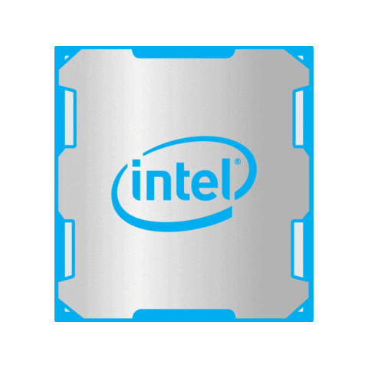

COMPONENTS
Microprocessor
Hard Disk Drive
Random Access Memory
Power Supply
Motherboard
DVD Writer
Graphics Card

Slide 14
PERIPHERALS
Peripherals are those Hardware items which are Hard, Visible & Touchable. The Hard Components of a computer system which are used by User. The Peripherals which are usually popular is like – Mouse, Keyboard & Monitor etc.

Slide 15
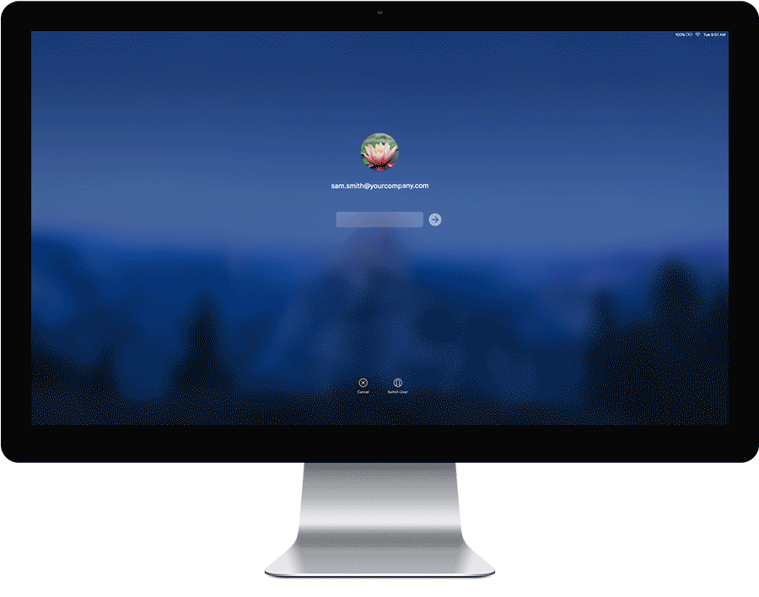
Types of Peripherals Devices
1. Input Devices :- Those Devices Which are used to give input in computer system are known as Input Devices
2. Output Devices :- Those Devices Which are used to take Output as result of our Input in our Computer System are known as Output Devices

Slide 16
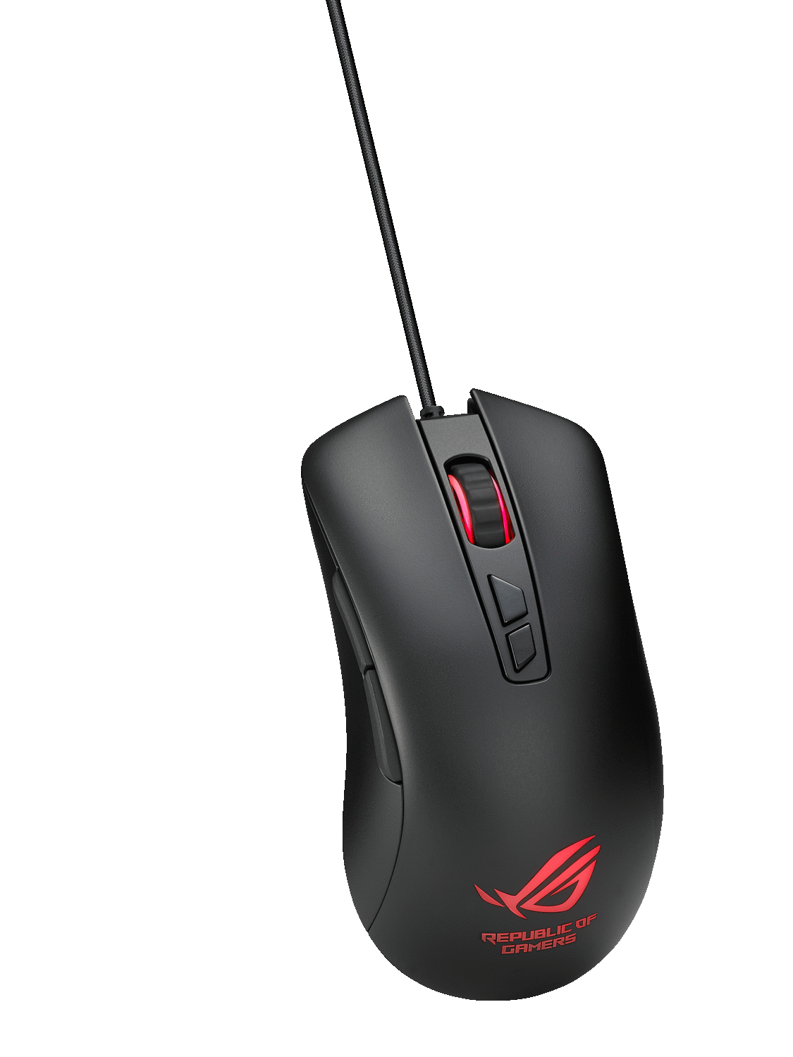
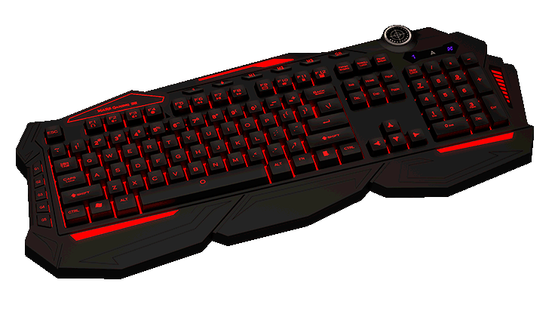
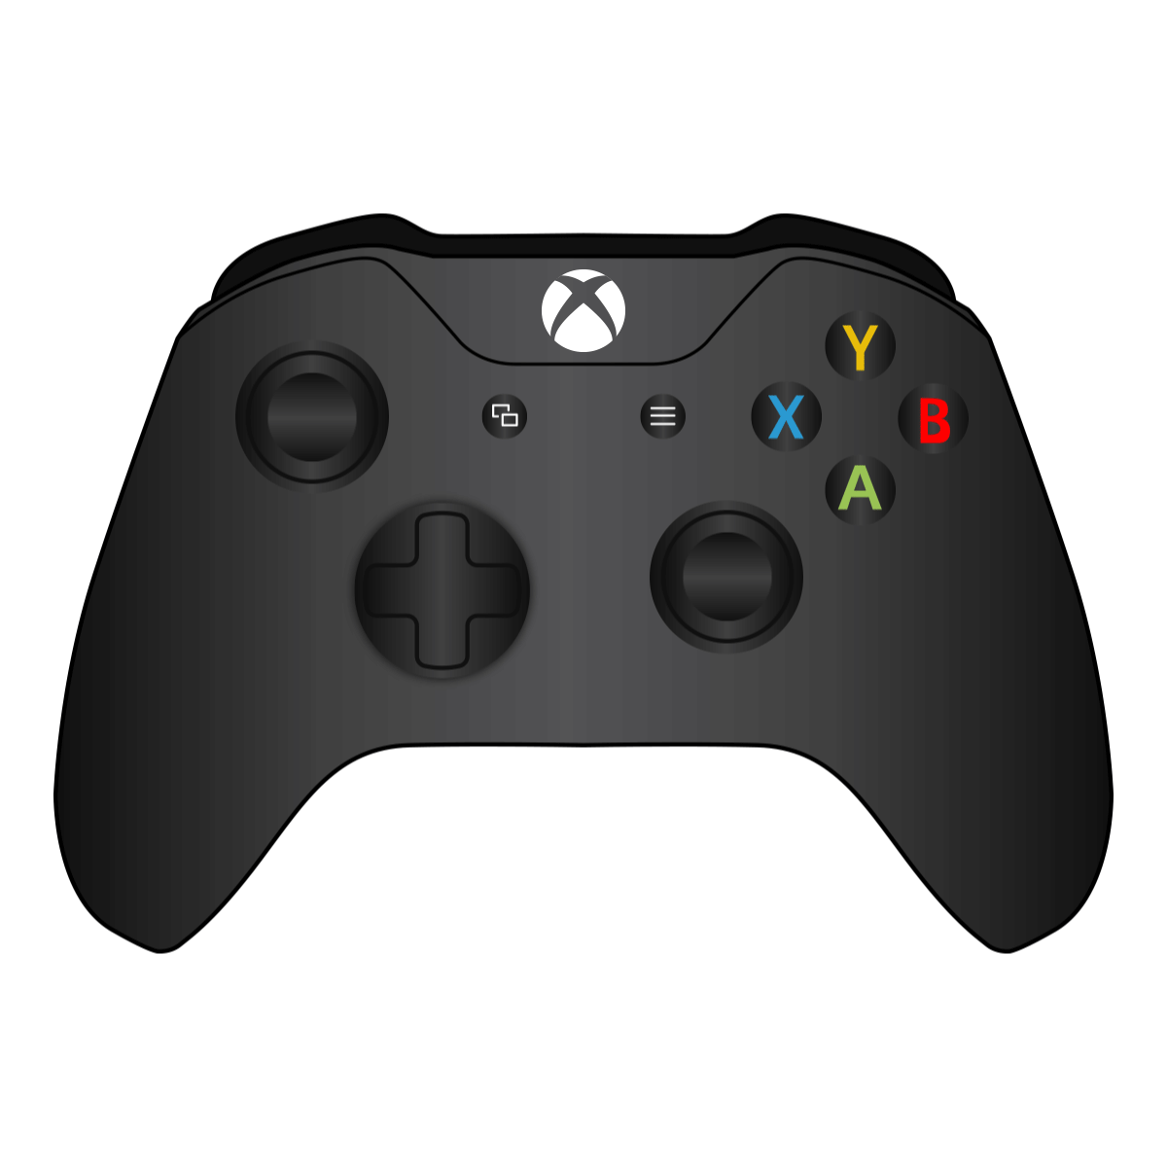

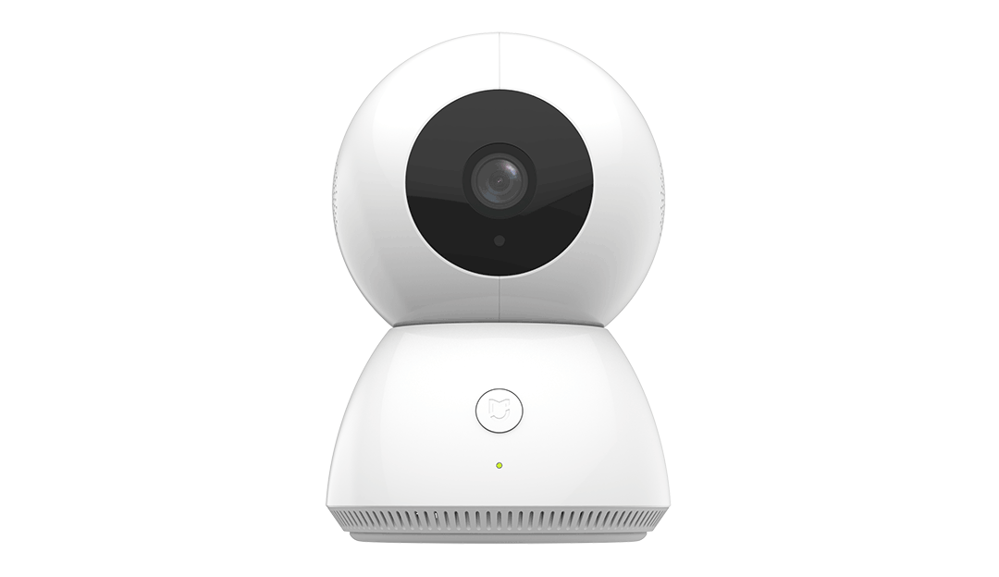
INPUT DEVICES
Keyboard
Mouse
Trackball
Graphics tablet
Game Controllers
Touch screen
Webcam
Microphone

Slide 17
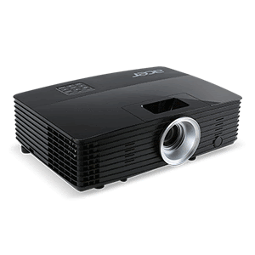
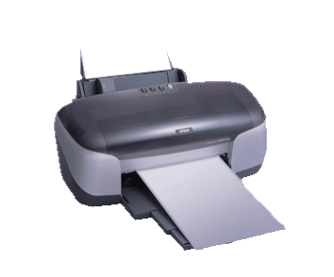

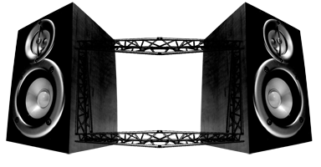
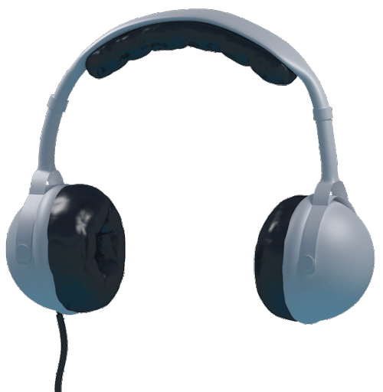
OUTPUT DEVICES
Monitor
Printer
Audio Speaker
Headphones
Projector
GPS
Sound Card
Video Card

Slide 18
Questions:-
1. RAM is a ___________ ? (Peripheral/Component)
2. TV Remote is an _____________ Device ? (Input/Output)
3. Apple iphone is a type of ___________ Computer ? (Mini/Micro/Workstation)
4. Which Computer is used high calculation ? (Workstation/Super)
5. Does Laptop really need DVD Writer to Run ? (Yes/No)
Solve all question and comment down answers...

